Slide 1
AMOGH SADHNA
Fulfilling Aspirations

Slide 2
Problem Statement
A technology solution to enhance the training practice for the ‘on the job’ training level modules.
Focus on entering details into an online form from a physical or scanned document.

Slide 3
Proposed Methodology:
Modular Approach.
Increasing level-wise difficulty.
Visual cue based questions
Positive reinforcement through smilies(and possibly sound) and badges.
Intensive guided practice of different formats.
Strengths & weaknesses.

Slide 4
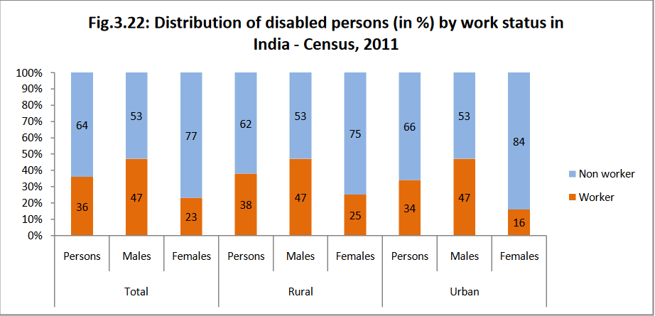

Slide 5

Future prospects:
Introduction of avatar.
Catering learning needs of other kinds of disability.
Better analytics for focused and effective teaching.

